Slide 1
Research and Citations
Title
www.url.com
Search
EBSCOhost
Citations from Ebsco
Formatting citations in Chicago style
Reynolds Secondary School Library
November 25, 2016
1

Slide 2
Citation Vocabulary
BE HONEST
Give credit where it is due!
Quotes should support your argument – not make it.
Title
www.url.com
Search
Bibliography
Citations
Endnotes
Footnotes
References
Works Cited
Endnotes and Footnotes are the same – just located in different places,
end of the paper or foot of the page.
1

Slide 3
At the end of the paper….
Bibliography - Chicago
Reference List - APA
Works Cited - MLA
Title
www.url.com
Search
A list of all the sources you consulted.
A bibliography includes the background material that you read for the paper, not just the ones that you cited.
1

Slide 4
Chicago
Title
www.url.com
Search
End/foot notes are punctuated as you would a sentence, with a period at the end.
Bibliography entries are punctuated as you would a paragraph. It consists of multiple sentences.
1

Slide 5
Chicago
Title
www.url.com
Search
The first time you mention a reference in your end/foot notes, it requires full details.
Any subsequent entries can be written as a Short Note.
1

Slide 6
Formatting
Title
www.url.com
Search
Both Google Docs and Word will insert numbers for citations and help with most of the formatting.¹
The reference list is always in alphabetical order and almost always has a “hanging indent”.
1

Slide 7
Title page and page numbers
Title
www.url.com
Search
For more information – including how to format a title page, check out…
Camosun Library - Chicago style references
1

Slide 8
Journal article, online
Janice B. Stockigt and Michael Talbot, “Two More New Vivaldi Finds in Dresden,” Eighteenth-Century Music 3, no. 1 (Spring 2006): 37, accessed May 5, 2010, doi: 10.1017/S1478570606000480.
Short note
Stockigt and Talbot, “Two More New Vivaldi Finds in Dresden,” 37
Bibliography
Stockigt, Janice B., and Michael Talbot. “Two More New Vivaldi Finds in Dresden.” Eighteenth-Century Music3, no. 1 (Spring 2006): 35-61. Accessed May 5, 2010. doi: 10.1017/S1478570606000480.
Stockigt, Janice B., and Michael Talbot. "Two More New Vivaldi Finds In Dresden." ECM Eighteenth-Century Music 3, no. 01 (2006): 35. doi:10.1017/s1478570606000480.
Notes:
HOME ACCESS!

Slide 9
EBSCOhost @ Reynolds

Slide 10
EBSCOhost
User name: reynolds
Password: student
Title
www.url.com
Search
1
Notes:
HOME ACCESS!

Slide 11
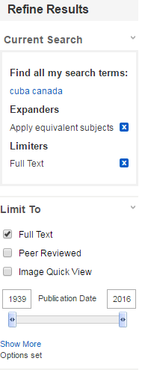
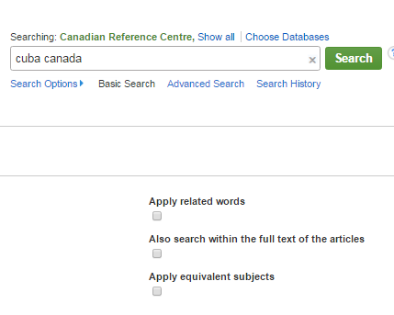
Be frugal with your search terms
Title
www.url.com
Search
And use the tools to refine the results.
1
Notes:
Check how Ebsco will prompt with common search terms

Slide 12
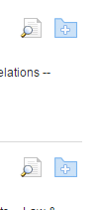
Abstracts and Folders
Title
www.url.com
Search
Are essential to use!
1

Slide 13
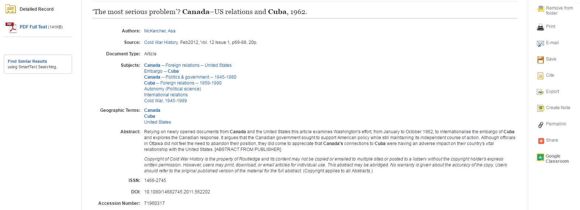

Slide 14
Paraphrase
Title
www.url.com
Search
10 Types of Plagiarism
1

Slide 15
Use Chicago Turabian Humanities format style
Copy, paste and be prepared to CHECK!

